Slide 1
Tow Tanks Test Dynamic Rig Cg Locations

Slide 2
Assumptions
Does not include track and I-beam hardware
Does not include tapered connector mass
I can include these but is a lot of work in the assembly model. Let me know if required.

Slide 3
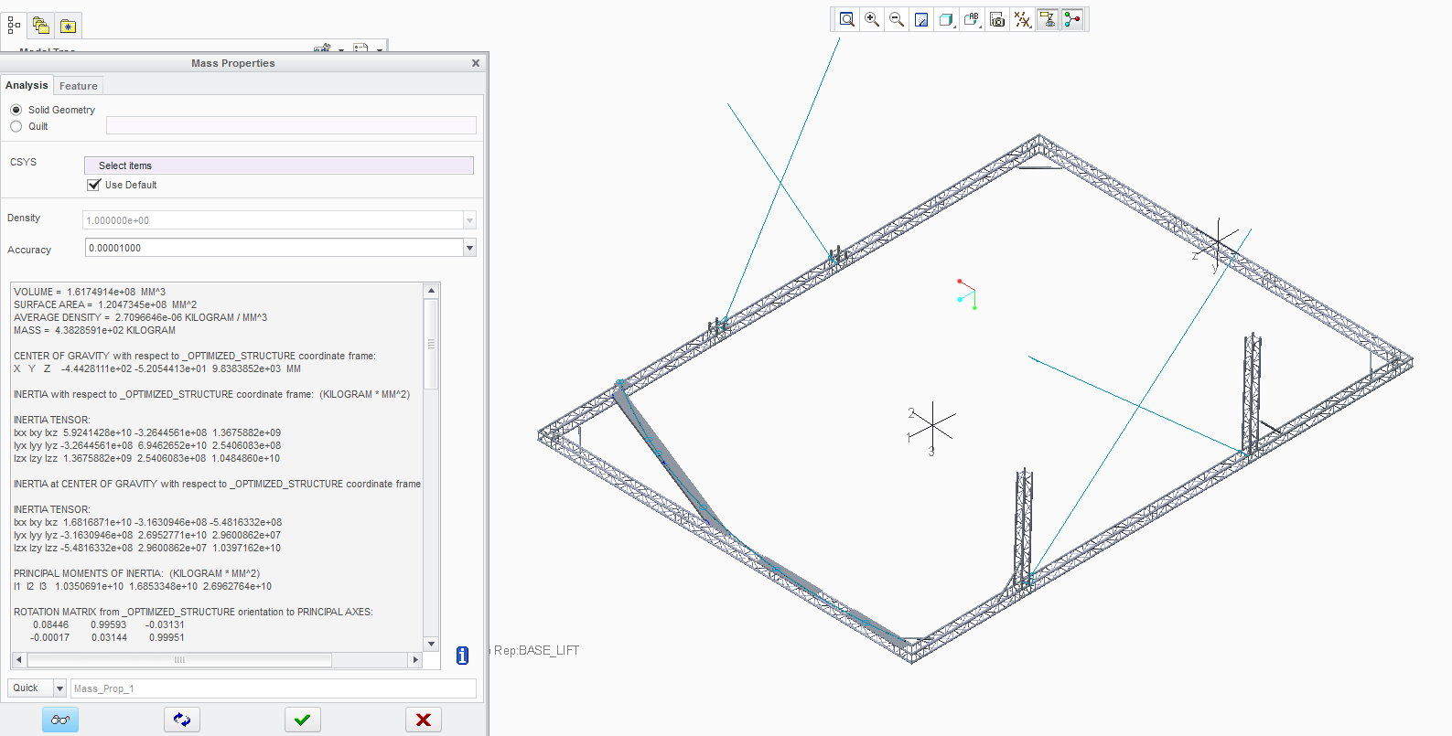
Lifting Option 1
9863mm (32.35 ft)
from back outer edge
6044mm (19.83 ft)
from STB side outer edge
317mm (1.04 ft)
Above floor

Slide 4
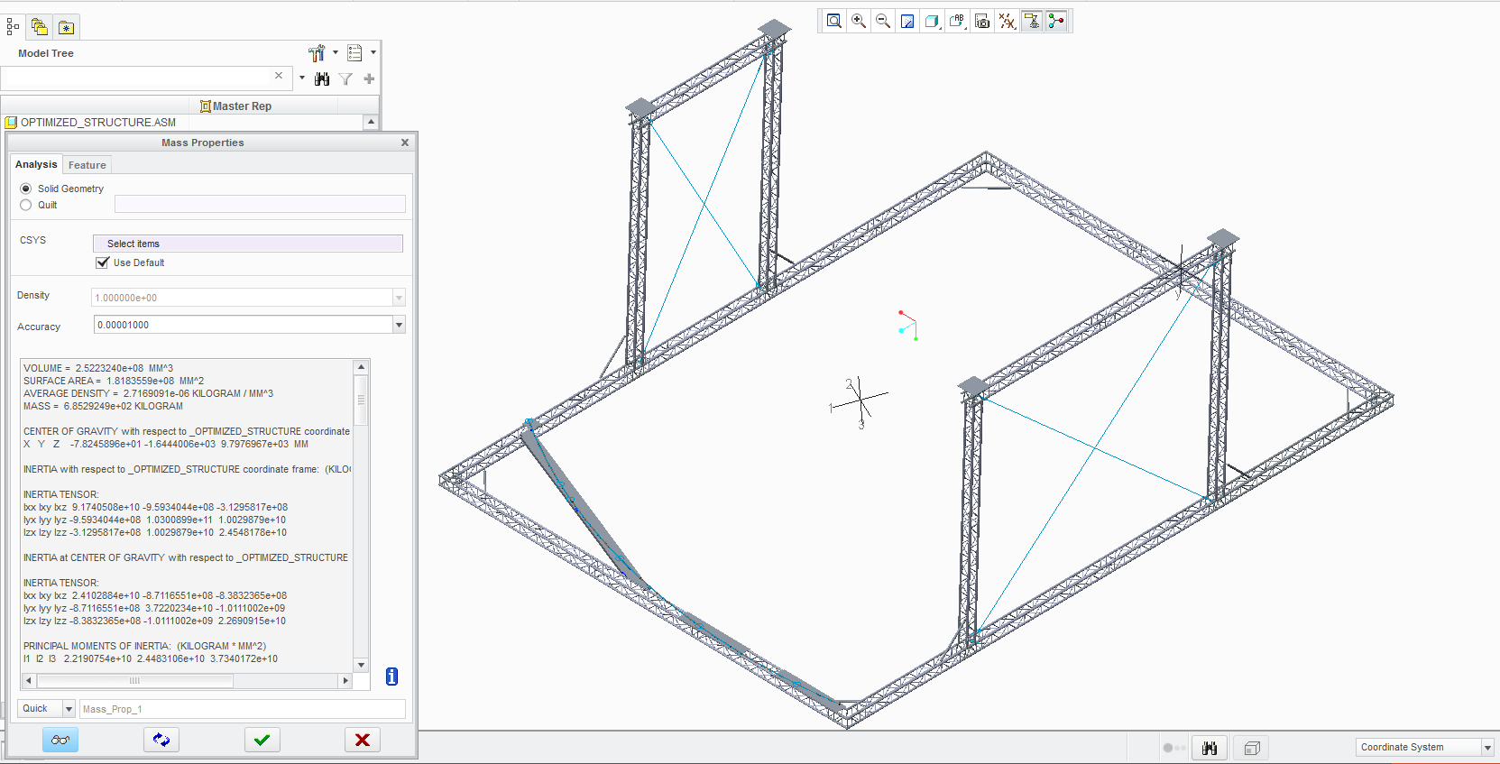
Lifting Option 2
9822mm (32.225 ft)
from back outer edge
6078mm (19.941 ft)
from STB side outer edge
1909mm (6.264 ft)
Above bottom

Slide 5
Lifting Locations (Ideal)

